Slide 1
ID3 Algorithm

Slide 2
Overview
ID3 Background
Entropy
Shannon Entropy
Information Gain
ID3 Algorithm
ID3 Example

Slide 3
ID3 Background
“Iterative Dichotomizer 3”.
Invented by Ross Quinlan in 1979.
Generates Decision Trees using Shannon Entropy.
Succeeded by Quinlan’s C4.5 and C5.0 algorithms.

Slide 4
Decision Tree for PlayTennis
Outlook
Sunny
Overcast
Rain
Humidity
Each internal node tests an attribute
High
Normal
Each branch corresponds to an
attribute value node
No
Yes
Each leaf node assigns a classification

Slide 5
Decision Tree for Conjunction
Outlook=Sunny ∧ Wind=Weak
Outlook
Sunny
Overcast
Rain
Wind
No
No
Strong
Weak
No
Yes

Slide 6
Decision Tree for Disjunction
Outlook=Sunny ∨ Wind=Weak
Outlook
Sunny
Overcast
Rain
Yes
Wind
Wind
Strong
Weak
Strong
Weak
No
Yes
No
Yes

Slide 7
Decision Tree
decision trees represent disjunctions of conjunctions
Outlook
Sunny
Overcast
Rain
Humidity
Yes
Wind
High
Normal
Strong
Weak
No
Yes
No
Yes
(Outlook=Sunny ∧ Humidity=Normal)
∨ (Outlook=Overcast)
∨ (Outlook=Rain ∧ Wind=Weak)

Slide 8
Entropy
In thermodynamics, entropy is a measure of how ordered or disordered a system is.
In information theory, entropy is a measure of how certain or uncertain the value of a random variable is (or will be).
Varying degrees of randomness, depending on the number of possible values and the total size of the set.

Slide 9
Shannon Entropy
Introduced by Claude Shannon in 1948
Quantifies “randomness”
Lower value implies less uncertainty
Higher value implies more uncertainty

Slide 10
Shannon Entropy
Entropy(S) = -p(I) log2 p(I)
where p(I) is the proportion of S belonging to class I. S is over c. Log2 is log base 2.
Note that S is not an attribute but the entire sample set.

Slide 11
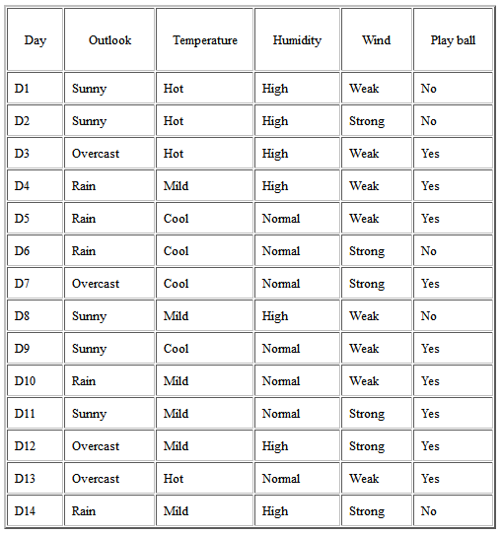
Assume Table below

Slide 12
Example 1
If S is a collection of 14 examples with 9 YES and 5 NO examples then
Entropy(S) = (- (9/14) Log2 (9/14))+( - (5/14) Log2 (5/14)) = 0.940
Notice entropy is 0 if all members of S belong to the same class (the data is perfectly classified). The range of entropy is 0 ("perfectly classified") to 1 ("totally random").
The one with lowest entropy becomes the target value/ class

Slide 13
Other Entropies?
Wind
Humidity
Temperature
Outlook?

Slide 14
Information Gain
Uses Shannon Entropy
IG calculates effective change in entropy after making a decision based on the value of an attribute.
For decision trees, it’s ideal to base decisions on the attribute that provides the largest change in entropy, the attribute with the highest gain.

Slide 15
Information Gain
Information Gain for attribute A on set S is defined by taking the entropy of S and subtracting from it the summation of the entropy of each subset of S, determined by values of A, multiplied by each subset’s proportion of S.
Gain(S, A) is information gain of example set S on attribute A is defined as
Gain(S, A) = Entropy(S) - S ((|S_{v}| / |S|) * Entropy(S_{v}))
Where:
S is each value v of all possible values of attribute A
S_{v} = subset of S for which attribute A has value v
|S_{v}| = number of elements in S_{v}
|S| = number of elements in S

Slide 16
Example 2
Suppose S is a set of 14 examples in which one of the attributes is wind speed.
The values of Wind can be Weak or Strong.
The classification of these 14 examples are 9 YES and 5 NO.
For attribute Wind, suppose there are 8 occurrences of Wind = Weak and 6 occurrences of Wind = Strong.
For Wind = Weak, 6 of the examples are YES and 2 are NO.
For Wind = Strong, 3 are YES and 3 are NO.
Therefore
Gain(S,Wind)=Entropy(S)-(8/14)*Entropy(S_{weak})-(6/14)*Entropy(S_{strong})
= 0.940 - (8/14)*0.811 - (6/14)*1.00
= 0.048
Entropy(S_{weak}) = - (6/8)*log2(6/8) - (2/8)*log2(2/8) = 0.811
Entropy(S_{strong}) = - (3/6)*log2(3/6) - (3/6)*log2(3/6) = 1.00
For each attribute, the gain is calculated and the highest gain is used in the decision node.

Slide 17
Gain(S, Outlook) = 0.246
Gain(S, Temperature) = 0.029
Gain(S, Humidity) = 0.151
Gain(S, Wind) = 0.048 (calculated in example 2)
Outlook attribute has the highest gain, therefore it is used as the decision attribute in the root node.

Slide 18
Deciding the root
Since Outlook has three possible values, the root node has three branches (sunny, overcast, rain).
The next question is "what attribute should be tested at the Sunny branch node?" Since we've already used Outlook at the root, we only decide on the remaining three attributes: Humidity, Temperature, or Wind.

Slide 19

Deciding the root

Slide 20
S_{sunny} = {D1, D2, D8, D9, D11} = 5 examples from table 1 with outlook = sunny
Gain(S_{sunny}, Humidity) = 0.970
Gain(S_{sunny}, Temperature) = 0.570
Gain(S_{sunny}, Wind) = 0.019
Humidity has the highest gain; therefore, it is used as the decision node. This process goes on until all data is classified perfectly or we run out of attributes.

Slide 21
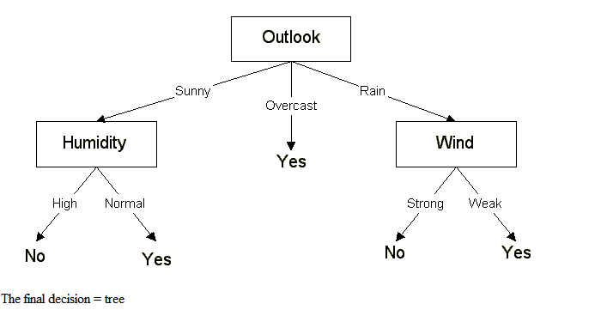

Slide 22
Converting a Tree to Rules
Outlook
Sunny
Overcast
Rain
Humidity
Yes
Wind
High
Normal
Strong
Weak
No
Yes
No
Yes
R₁: If (Outlook=Sunny) ∧ (Humidity=High) Then PlayTennis=No
R₂: If (Outlook=Sunny) ∧ (Humidity=Normal) Then PlayTennis=Yes
R₃: If (Outlook=Overcast) Then PlayTennis=Yes
R₄: If (Outlook=Rain) ∧ (Wind=Strong) Then PlayTennis=No
R₅: If (Outlook=Rain) ∧ (Wind=Weak) Then PlayTennis=Yes

Slide 23
The final decision = tree
The decision tree can also be expressed in rule format:
IF outlook = sunny AND humidity = high THEN playball = no
IF outlook = rain AND humidity = high THEN playball = no
IF outlook = rain AND wind = strong THEN playball = yes
IF outlook = overcast THEN playball = yes
IF outlook = rain AND wind = weak THEN playball = yes

Slide 24
ID3 Algorithm
1) Establish Classification Attribute (in Table R)
2) Compute Classification Entropy.
3) For each attribute in R, calculate Information Gain using classification attribute.
4) Select Attribute with the highest gain to be the next Node in the tree (starting from the Root node).
5) Remove Node Attribute, creating reduced table R_{S}.
6) Repeat steps 3-5 until all attributes have been used, or the same classification value remains for all rows in the reduced table.

Slide 25
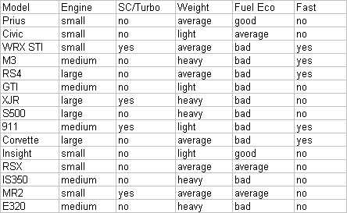
Example

Slide 26
Example
Model Attribute can be tossed out, since its always unique, and it doesn’t help our result.

Slide 27
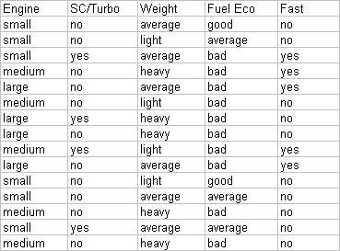
Example
Establish a target classification
Is the car fast?
6/15 yes, 9/15 no

Slide 28
Example – Classification Entropy
Calculating for the Classification Entropy
I_{E}= -(6/15)log₂(6/15)-(9/15)log₂(9/15) = ~0.971
Must calculate Information Gain of remaining attributes to determine the root node.

Slide 29
Example – Information Gain
Engine: 6 small, 5 medium, 4 large
3 values for attribute engine, so we need 3 entropy calculations
small: 5 no, 1 yes | I_{small} = -(5/6)log₂(5/6)-(1/6)log₂(1/6) = ~0.65
medium: 3 no, 2 yes | I_{medium} = -(3/5)log₂(3/5)-(2/5)log₂(2/5) = ~0.97
large: 2 no, 2 yes | I_{large} = 1 (evenly distributed subset)
IG_{Engine} = IE(S) – [(6/15)*I_{small} + (5/15)*I_{medium} + (4/15)*I_{large}]
IG_{Engine} = 0.971 – 0.85 = 0.121

Slide 30
Example – Information Gain
SC/Turbo: 4 yes, 11 no
2 values for attribute SC/Turbo, so we need 2 entropy calculations
yes: 2 yes, 2 no | I_{turbo} = 1 (evenly distributed subset)
no: 3 yes, 8 no | I_{noturbo} = -(3/11)log₂(3/11)-(8/11)log₂(8/11) = ~0.84
IG_{turbo} = IE(S) – [(4/15)*I_{turbo} + (11/15)*I_{noturbo}]
IG_{turbo} = 0.971 – 0.886 = 0.085

Slide 31
Example – Information Gain
Weight: 6 Average, 4 Light, 5 Heavy
3 values for attribute weight, so we need 3 entropy calculations
average: 3 no, 3 yes | I_{average} = 1 (evenly distributed subset)
light: 3 no, 1 yes | I_{light} = -(3/4)log₂(3/4)-(1/4)log₂(1/4) = ~0.81
heavy: 4 no, 1 yes | I_{heavy} = -(4/5)log₂(4/5)-(1/5)log₂(1/5) = ~0.72
IG_{Weight} = IE(S) – [(6/15)*I_{average} + (4/15)*I_{light} + (5/15)*I_{heavy}]
IG_{Weight} = 0.971 – 0.856 = 0.115

Slide 32
Example – Information Gain
Fuel Economy: 2 good, 3 average, 10 bad
3 values for attribute Fuel Eco, so we need 3 entropy calculations
good: 0 yes, 2 no | I_{good} = 0 (no variability)
average: 0 yes, 3 no | I_{average} = 0 (no variability)
bad: 5 yes, 5 no | I_{bad} = 1 (evenly distributed subset)
We can omit calculations for good and average since they always end up not fast.
IG_{FuelEco} = IE(S) – [(10/15)*I_{bad}]
IG_{FuelEco} = 0.971 – 0.667 = 0.304

Slide 33
Example – Choosing the Root Node
Recap:
IG_{Engine} | 0.121
IG_{turbo} | 0.085
IG_{Weight} | 0.115
IG_{FuelEco} | 0.304
Our best pick is Fuel Eco, and we can immediately predict the car is not fast when fuel economy is good or average.

Slide 34
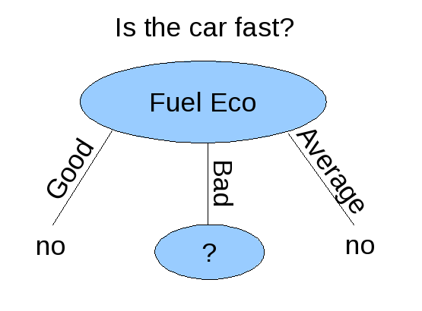
Example – Root of Decision Tree

Slide 35
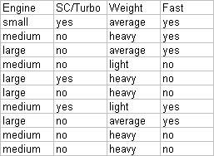
Example – After Root Node Creation
Since we selected the Fuel Eco attribute for our Root Node, it is removed from the table for future calculations.
Calculating for Entropy I_{E}(Fuel Eco) we get 1, since we have 5 yes and 5 no.

Slide 36
Example – Information Gain
Engine: 1 small, 5 medium, 4 large
3 values for attribute engine, so we need 3 entropy calculations
small: 1 yes, 0 no | I_{small} = 0 (no variability)
medium: 2 yes, 3 no | I_{medium} = -(2/5)log₂(2/5)-(3/5)log₂(3/5) = ~0.97
large: 2 no, 2 yes | I_{large} = 1 (evenly distributed subset)
IG_{Engine} = IE(S_{FuelEco}) – (5/10)*I_{medium} + (4/10)*I_{large}]
IG_{Engine} = 1 – 0.885 = 0.115

Slide 37
Example – Information Gain
SC/Turbo: 3 yes, 7 no
2 values for attribute SC/Turbo, so we need 2 entropy calculations
yes: 2 yes, 1 no | I_{turbo} = -(2/3)log₂(2/3)-(1/3)log₂(1/3) = ~0.84
no: 3 yes, 4 no | I_{noturbo} = -(3/7)log₂(3/7)-(4/7)log₂(4/7) = ~0.84
IG_{turbo} = IE(S_{FuelEco}) – [(3/10)*I_{turbo} + (7/10)*I_{noturbo}]
IG_{turbo} = 1 – 0.965 = 0.035

Slide 38
Example – Information Gain
Weight: 3 average, 5 heavy, 2 light
3 values for attribute weight, so we need 3 entropy calculations
average: 3 yes, 0 no | I_{average} = 0 (no variability)
heavy: 1 yes, 4 no | I_{heavy} = -(1/5)log₂(1/5)-(4/5)log₂(4/5) = ~0.72
light: 1 yes, 1 no | I_{light} = 1 (evenly distributed subset)
IG_{Engine} = IE(S_{Fuel Eco}) – [(5/10)*I_{heavy}+(2/10)*I_{light}]
IG_{Engine} = 1 – 0.561 = 0.439

Slide 39
Example – Choosing the Level 2 Node
Recap:
IG_{Engine} | 0.115
IG_{turbo} | 0.035
IG_{Weight} | 0.439
Weight has the highest gain, and is thus the best choice.

Slide 40
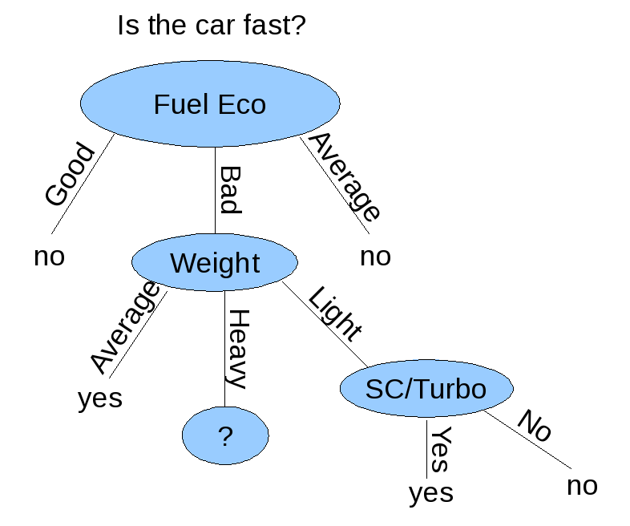
Example – Decision Tree
Since there are only two items for SC/Turbo where Weight = Light, and the result is consistent, we can simplify the weight = Light path.

Slide 41
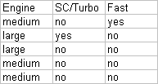
Example – Updated Table
All cars with large engines in this table are not fast.
Due to inconsistent patterns in the data, there is no way to proceed since medium size engines may lead to either fast or not fast.

Slide 42
Advantages of using ID3
Understandable prediction rules are created from the training data.
Builds the fastest tree.
Builds a short tree.
Only need to test enough attributes until all data is classified.
Finding leaf nodes enables test data to be pruned, reducing number of tests.
Whole dataset is searched to create tree.

Slide 43
Disadvantages of using ID3
Data may be over-fitted or over-classified, if a small sample is tested.
Only one attribute at a time is tested for making a decision.
Classifying continuous data may be computationally expensive, as many trees must be generated to see where to break the continuum.

Slide 44
Conclusion
ID3 attempts to make the shortest decision tree out of a set of learning data, shortest is not always the best classification.
Requires learning data to have completely consistent patterns with no uncertainty.

Slide 45
Conclusion
ID3 has been incorporated in a number of commercial rule-induction packages. Some specific applications include medical diagnosis, credit risk assessment of loan applications, equipment malfunctions by their cause, classification of soybean diseases, and web search classification.

Slide 46
Exercise

Slide 47
References
Quinlan, J. R (1985). Induction of Decision Trees, Machine Learning 1: 81-106, 1986.
Ross, Peter (10/30/2000). Rule Induction: Ross Quinlan’s ID3 Algorithm (Retrieved 04/23/2010). http://www.dcs.napier.ac.uk/~peter/vldb/dm/node11.html
Author Unknown. (Fall 1997). The ID3 Algorithm. Retrieved (Retrieved 04/23/2010). http://www.cise.ufl.edu/~ddd/cap6635/Fall-97/Short-papers/2.htm
Elmasri, Navathe (2007). Fundamentals of Database Systems (5th Edition), 975-977.
Shannon, Claude E. Prediction and Entropy of Printed English. (Retrieved 04/23/2010). http://languagelog.ldc.upenn.edu/myl/Shannon1950.pdf
http://www.cise.ufl.edu/~ddd/cap6635/Fall-97/Short-papers/2.htm
http://cis.k.hosei.ac.jp/~rhuang/Miccl/AI-2/L10-src/DecisionTree2.pdf
https://www.cs.auckland.ac.nz/courses/compsci367s1c/lectures/Pat.d/tut_week7_v4-1.pdf

